Slide 1
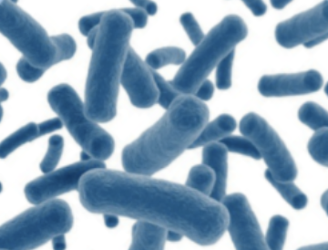
MicrobiomeAnalyst
Marker Data Profiling (MDP): Visual Exploration and Community Profiling
Andrew Reid and Asylzhan Almukhamet
Notes:
Goal: To provide a real-time platform for maker gene data analysis that allows users to easily explore and understand their data using updated methods and knowledge databases.

Slide 2
Key Features
Support for a wide array of common as well as advanced methods for taxonomic diversity analysis, functional profiling, visualization and significance testing
Comprehensive support for various data filtering and transformation methods coupled with well-established as well as more recent algorithms for differential abundance analysis
A powerful, fully-featured metabolic network visualization framework for intuitive exploration of results from functional profiling
Support for meta-analysis with compatible public datasets for context reference and pattern discovery using 3D visual analytics
Enrichment analysis based on >300 taxon sets manually collected from literature and public databases
Notes:
MicrobiomeAnalyst is a web-based program to allow clinical and basic scientists to easily perform exploratory analysis on common abundance profiles and taxonomic signatures generated from microbiome studies
Based on Java, R and Javascript > R and JavaServer

Slide 3
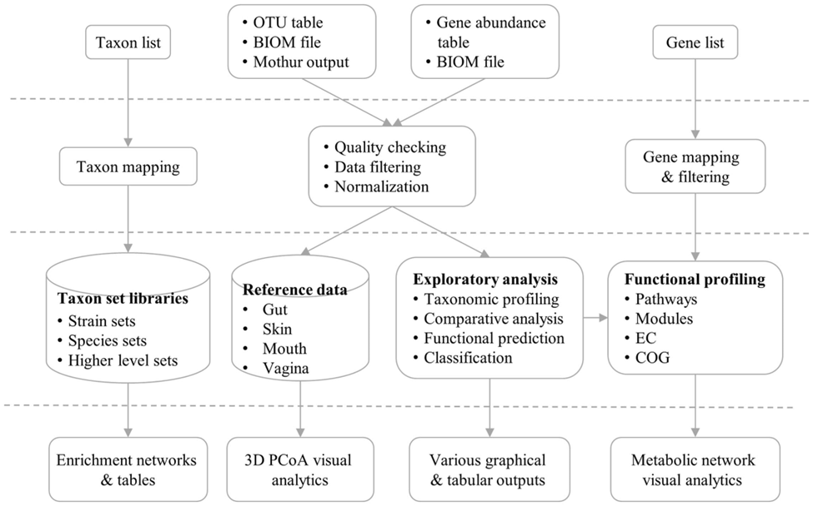
MicrobiomeAnalyst flow chart
Notes:
MicrobiomeAnalyst accepts taxa/gene lists, OTU/gene abundance tables, or BIOM files. Three consecutive steps are performed - data processing, data analysis, and result exploration. The associated web interface offers a rich set of options, and produces various tables and graphics to allow users to intuitively navigate the data analysis tasks.

Slide 4
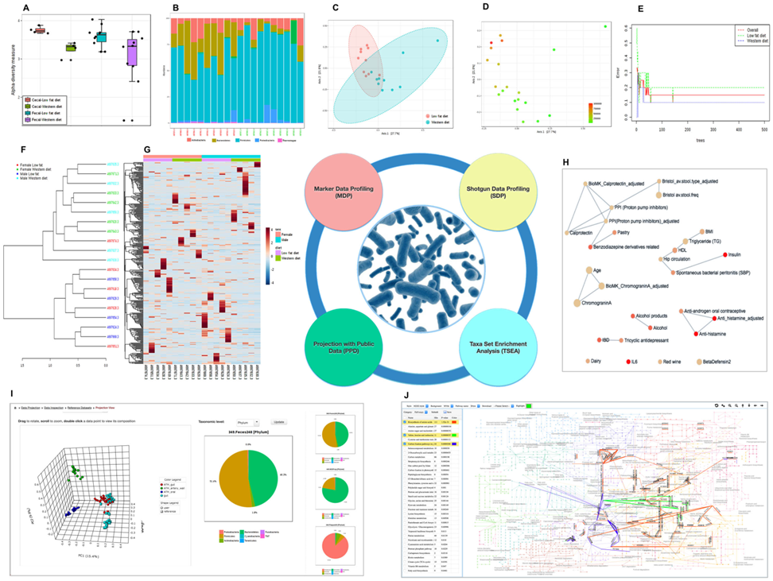
Example Outputs
Notes:
(A) A box plot summary of the Shannon diversity index across different groups. (B) A stacked bar chart showing Phylum level abundance profiles across samples. Sample names in red and green colors indicate mice fed a low fat diet (LFD) and a western-style diet (WSD), respectively. (C) A PCoA plot with sample colors based on different diets. (D) The same PCoA plot with color gradients based on the abundance levels of family Bacteroidaceae. (E) A graphical summary of the classification performance on different diets using the Random Forests algorithm. (F) A dendrogram showing the clustering of samples with colors based on diet and sex. (G) A clustered heatmap showing the variation of taxonomic abundance with regard to diet and sex. (H) An interactive network summarizing enriched taxon sets from TSEA. (I) A 3D PCoA plot from the PPD module, with the taxonomic composition of the currently selected sample shown in the middle and the session history on the right. (J) A screenshot showing functional enrichment analysis and visualization within the global metabolic network.

Slide 5
Analysis Strategies
Visual Exploration
Community Profiling
Clustering & Correlation
Comparison & Classification
Functional Prediction
Interactive stack
Bar/area plot
Interactive pie chart
Rarefaction curve
Phylogenetic tree
Heat tree
Alpha diversity
Beta diversity
Core microbiome
Interactive heatmap
Dendogram
Correlation network
Pattern search
Single-factor analysis
Multi-factor analysis
LEfSe
Random forest
PICRUSt (Greengenes)
Tax4Fun (SILVA)
Tax4Fun2

Slide 6
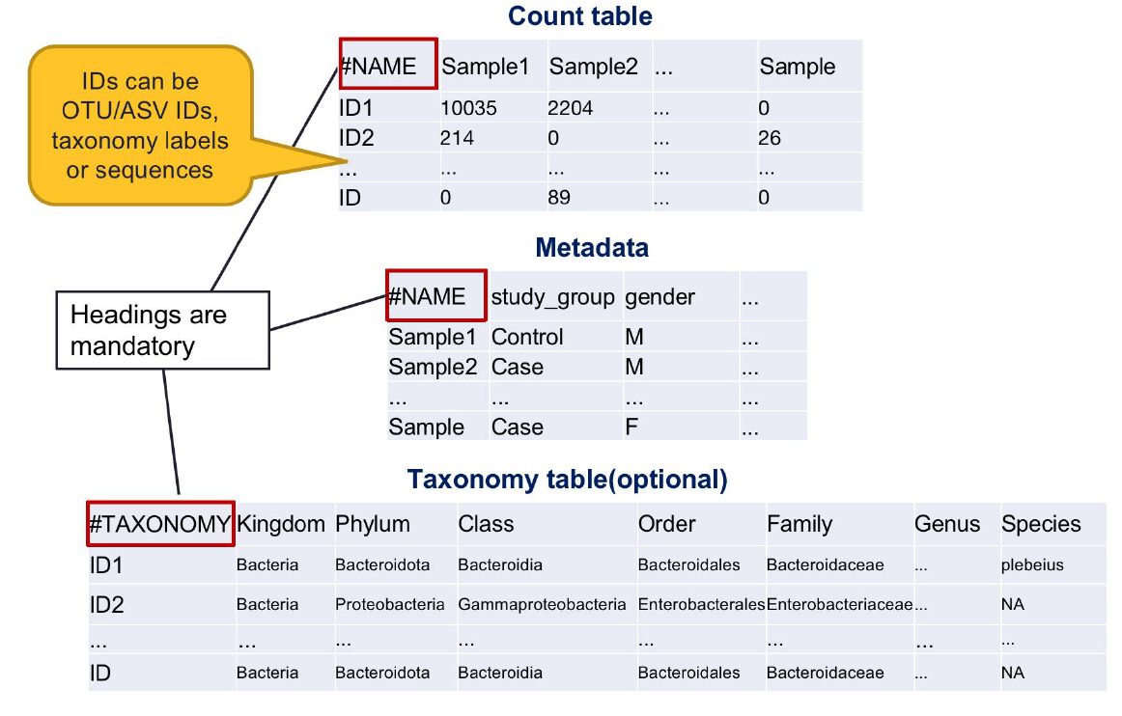
Data Formatting
Text file:
tab delimited (.txt)
comma-separated (.csv) file
BIOM format
Mothur output:
.shared (abundance) file
.taxonomy file
Notes:
Taxonomic profiles derived from both amplified 16S rRNA census data and whole-genome shotgun metagenomic data can be uploaded. The following formats are accepted (accompanying example metadata files are also given below):
mothur: This format has both a consensus taxonomy file and a .shared file.
BIOM format consists of an abundance profile in .biom format. Here, the metadata file can be provided separately, if not already present within the .biom file.
Tab-separated (.txt) files: This format consists of either an abundance file with a separate file of corresponding taxonomy mapping information, or an abundance file directly including taxonomic information. Note that metadata information is included in such files.
Notes when formatting your data:
Both sample and feature names must be unique and consist of a combination of common English letters, underscores and numbers for naming purpose. Latin/Greek letters are not supported.
Sample and feature names must be consistent across all files (i.e. abundance table, taxonomy table, meta-data file, and phylogenetic tree file).
Data values (read counts or proportions) should contain only numeric and positive values. Empty cells or cells with NA values will be replaced with zero.
Leaving cells blank or "NA" (without quotes) for missing values are allowed in the taxonomy table. These values are considered to represent the maximum taxonomic resolution obtained for each OTU or feature.
Metadata is not permitted to be included in the abundance tables (i.e. do not add another row following #NAME with #CLASS).

Slide 7
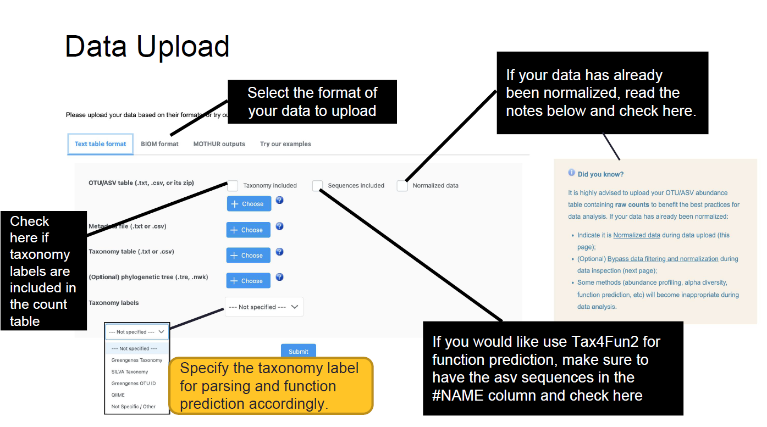
Data Upload
Notes:
Tax4Fun2 provides researchers with a unique tool to predict and investigate functional profiles of prokaryotic communities based on 16S rRNA gene sequencing data

Slide 8
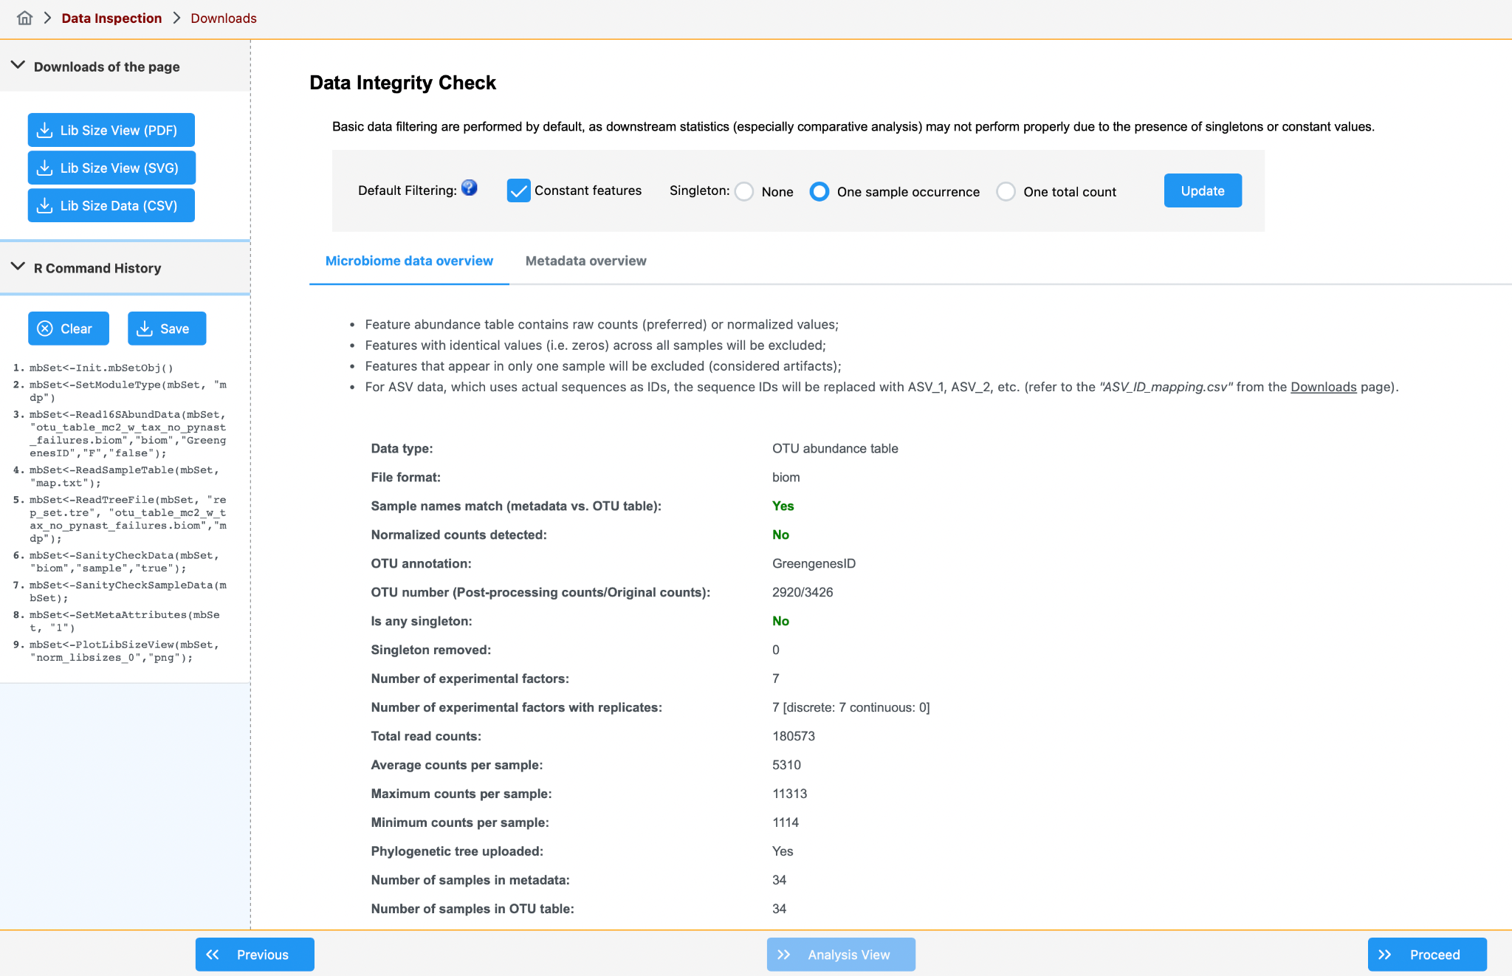
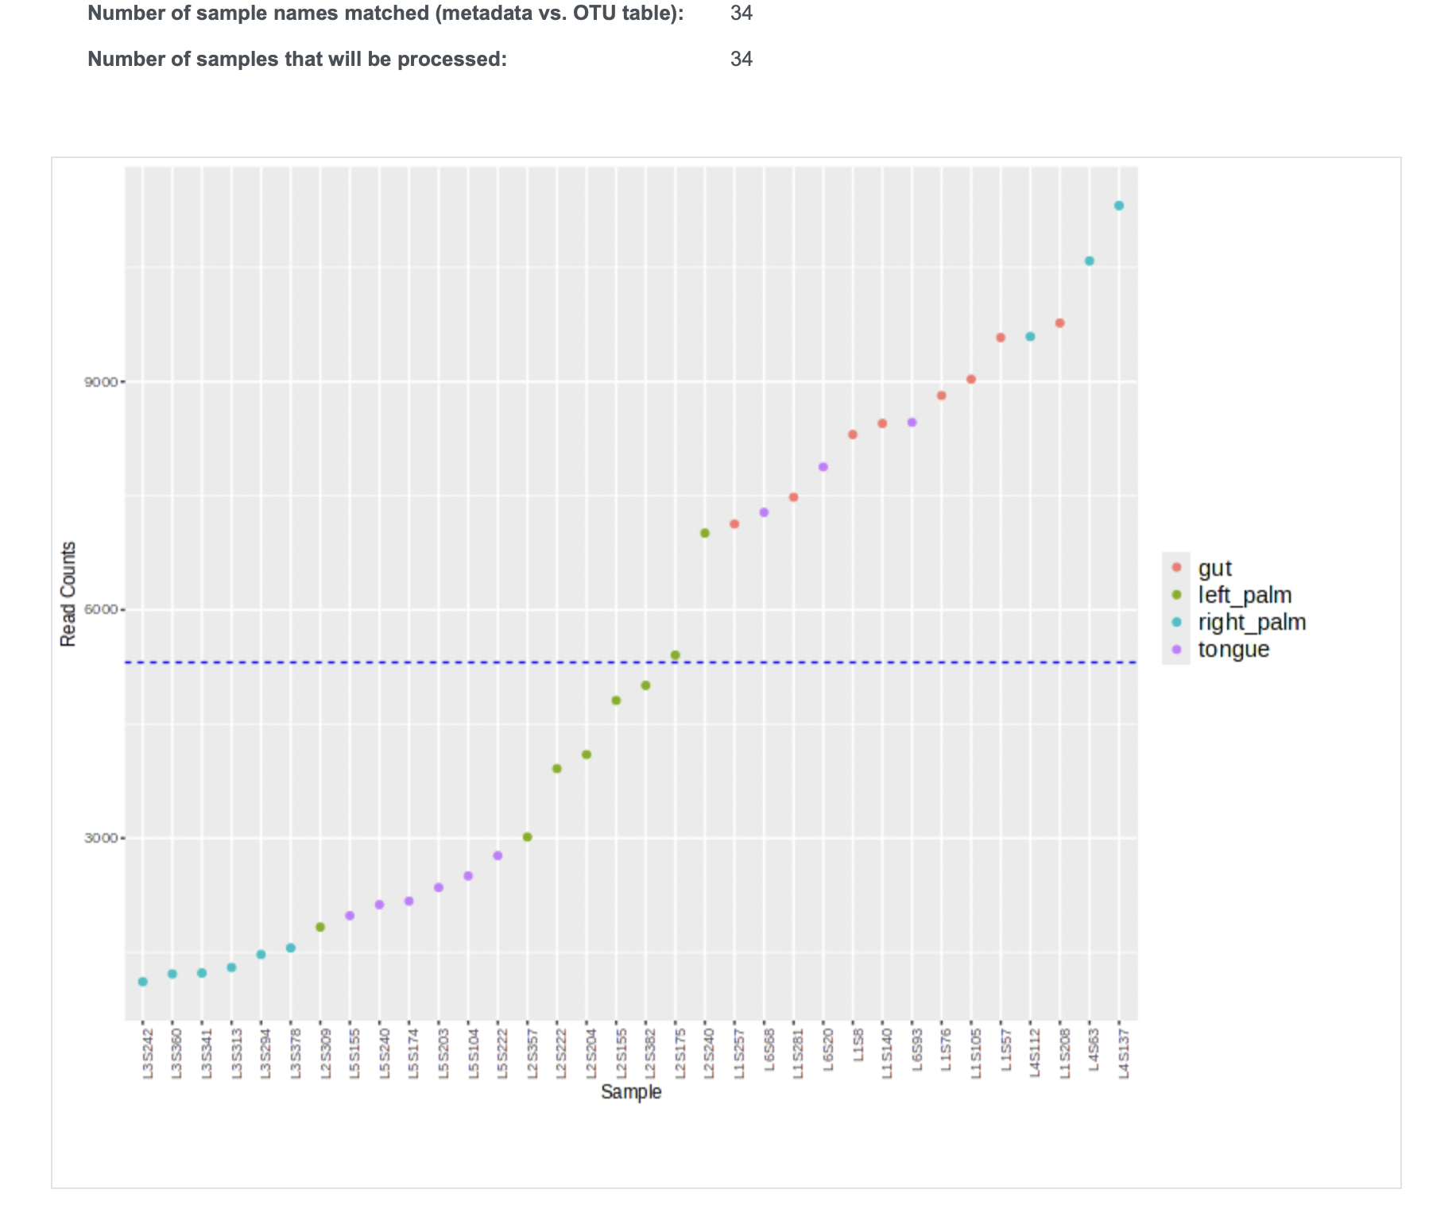
Data Integrity Check
Possible file downloads are available here
Read Count Distribution Plot- one of the first quality check visuals
R commands are available here
Note: only name matched samples will be processed
Notes:
Features that are constant across all samples are removed by default to benefit the differential analysis.
Singletons, defined as features that appear in only one sample or those with a single count across all samples, are typically removed by default since they are often considered artifacts. There is an option to adjust the settings.
For ASV inputs, it would be recommended to remove only those features with a single count in order to retain rare features.

Slide 9
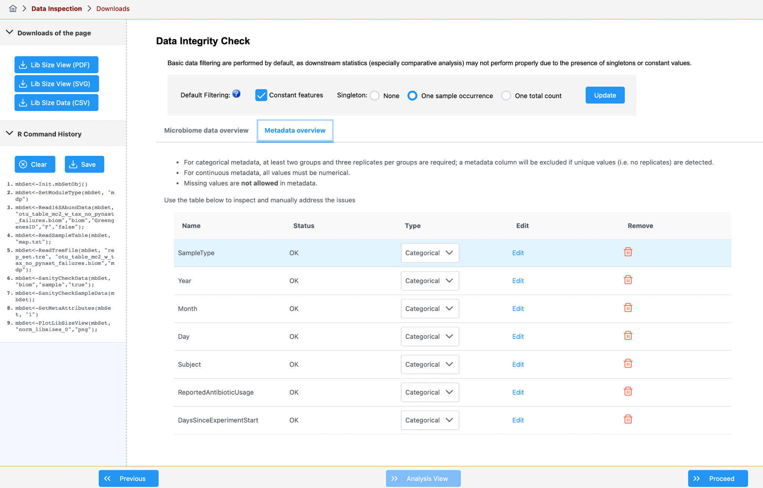
Edit metadata
Make sure all
variable types are inferred correctly

Slide 10
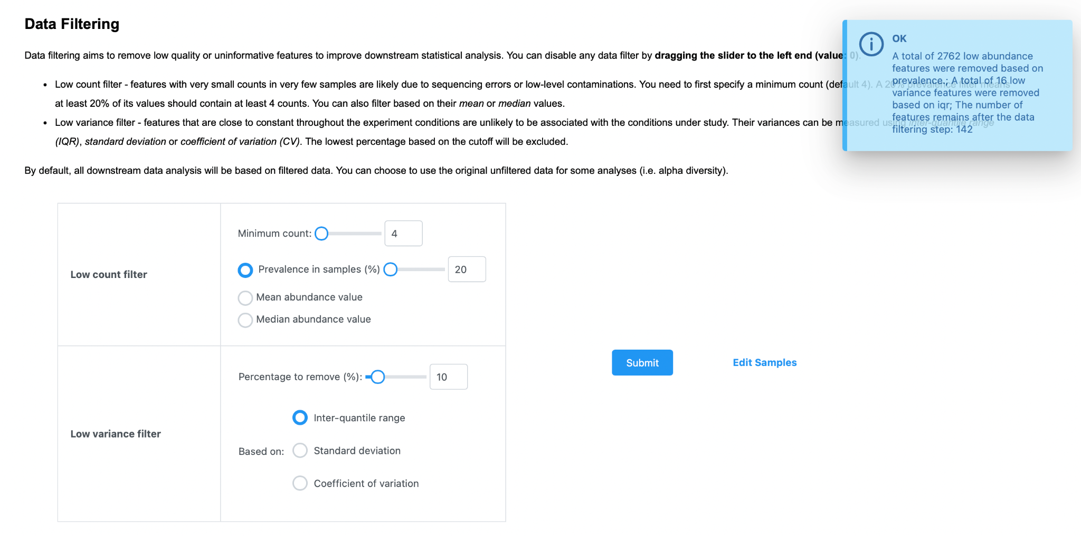
Data Filtering
Filtering result will present here after submit

Slide 11
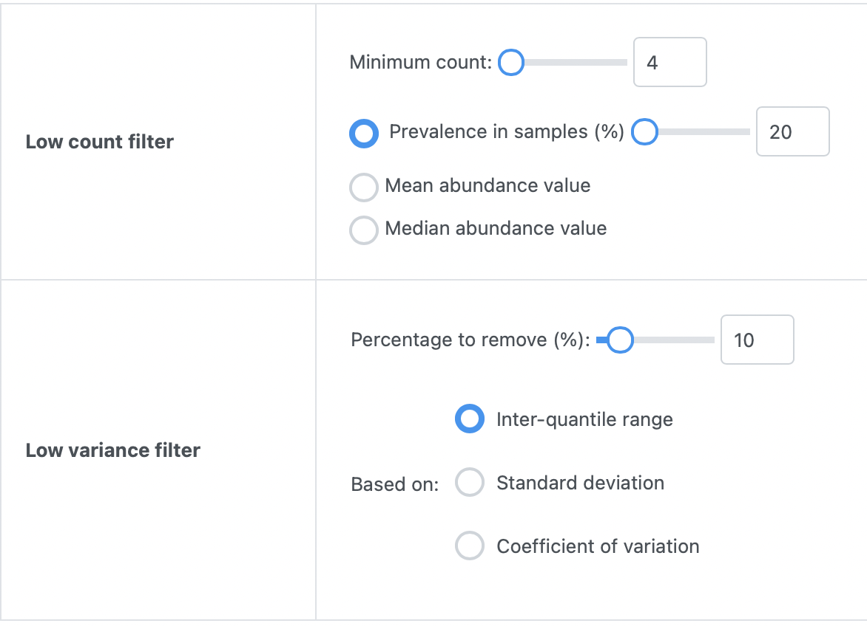
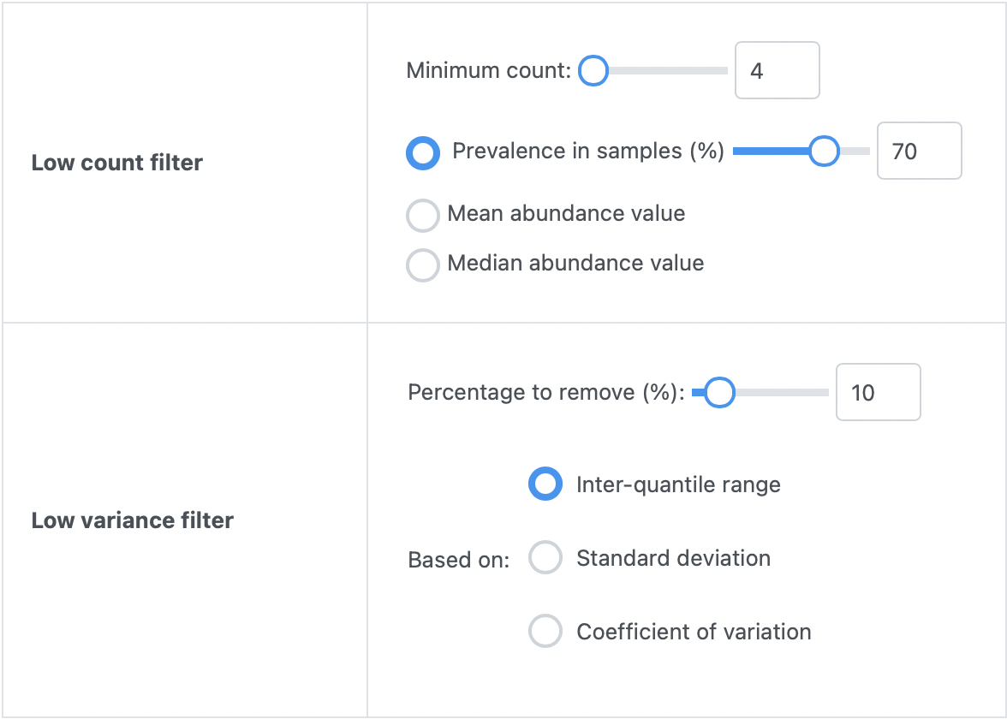
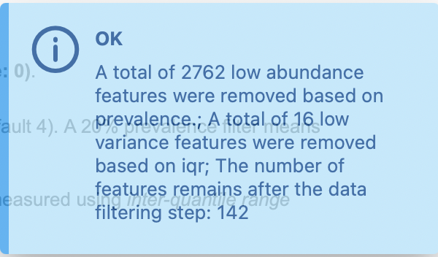
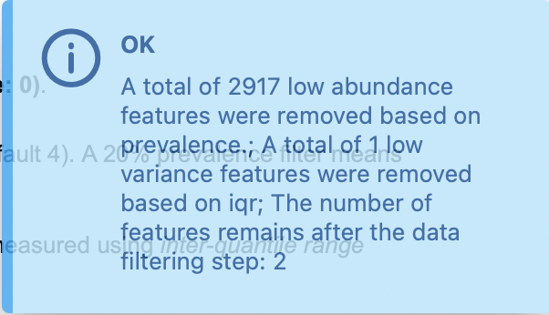
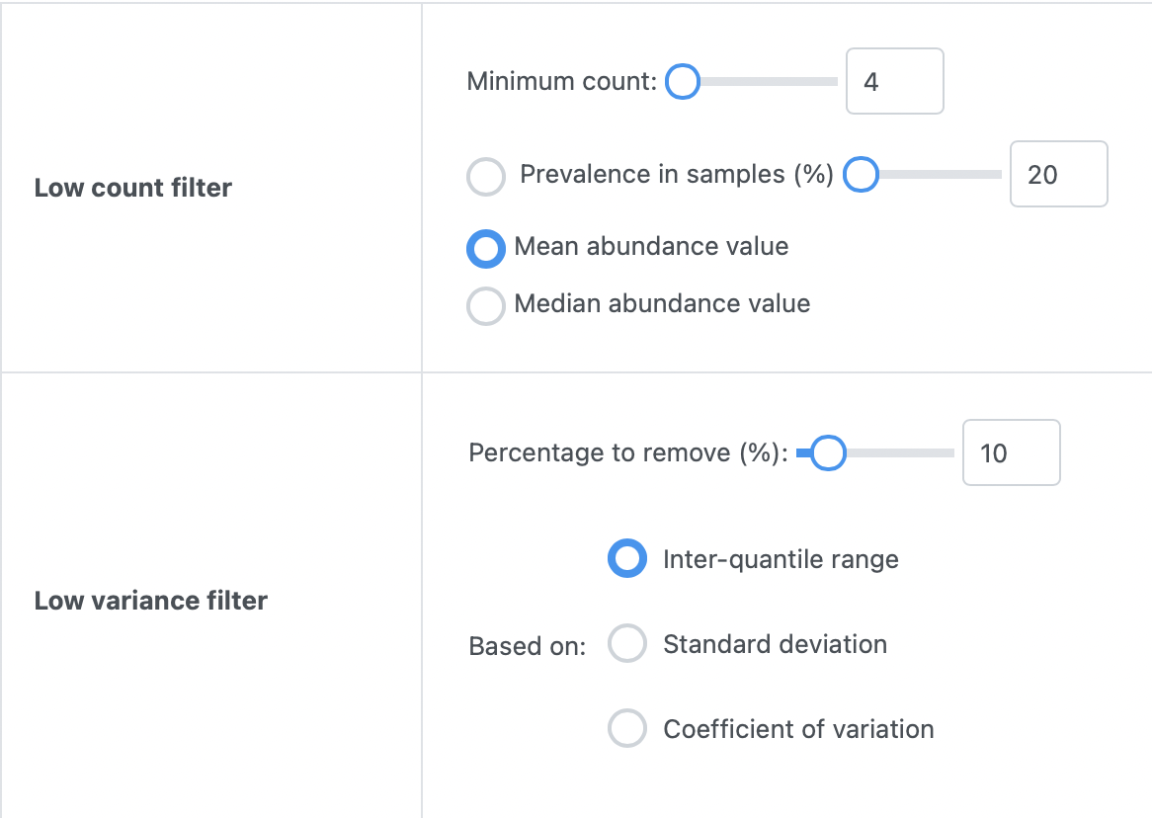
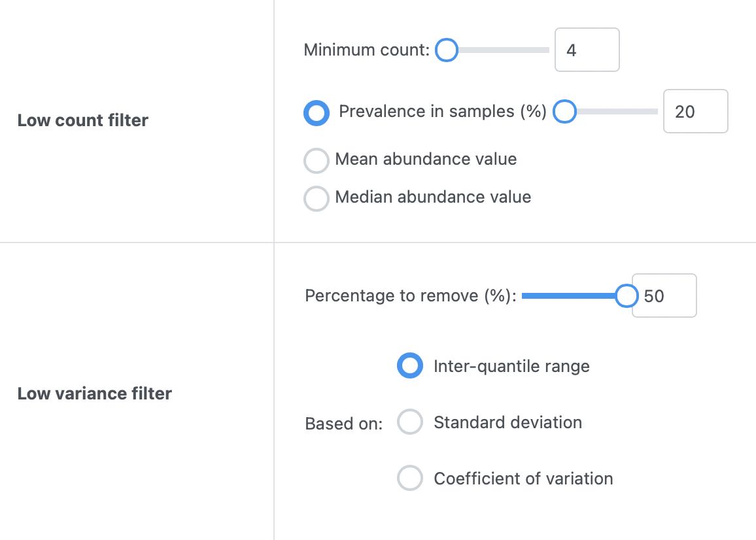
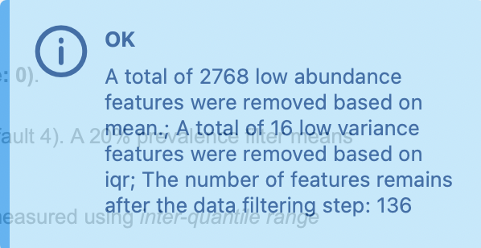
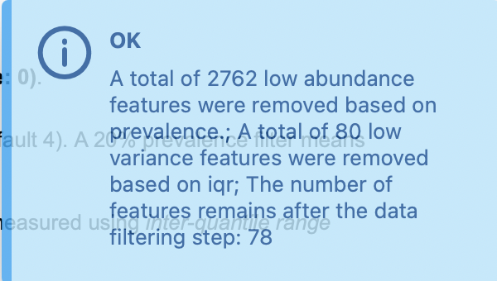
Control
Higher prevalence means:
-stricter filtering
-more low-abundance features were removed
-fewer remaining features
-more feature sets were filtered out
Change to prevalence
Filtering by mean abundance:
-mean keeps taxa above the mean abundance
-slightly more of low-abundance features
-slightly fewer features
Low variance thresholds:
-removes more features
-almost double of feature sets were reduced
Change to low variance filter: % to remove
Choosing mean

Slide 12
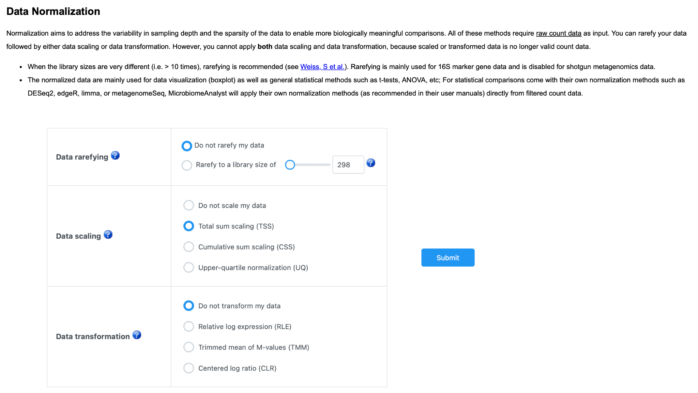
Data Normalization
There are 3 categories:
-rarefaction
-data scaling
-data transformation
Notes:
Data rarefying
All samples will be rarefied to even sequencing depth based on the sample having the lowest sequencing depth. If this sample contains extremely low reads, you may need to manually exclude the sample (using Sample Editor) to avoid significant data loss. You can find out if this is the case from View Sample Size from the Data Summary page.
Data scaling:
The method aims to bring all samples to the same scale by dividing the samples by a scaling factor. Some common choices included total sum scaling (TSS), cumulative sum scaling (CSS) and upper-quantile scaling (UQ).
Data transformation:
Variance stabilization transformation such as log-ratio transformation and its variations. Some common choices included centered log-ratio (CLR) transformation, relative log expression (RLE) normalization or weighted trimmed mean of M-values (TMM).

Slide 13
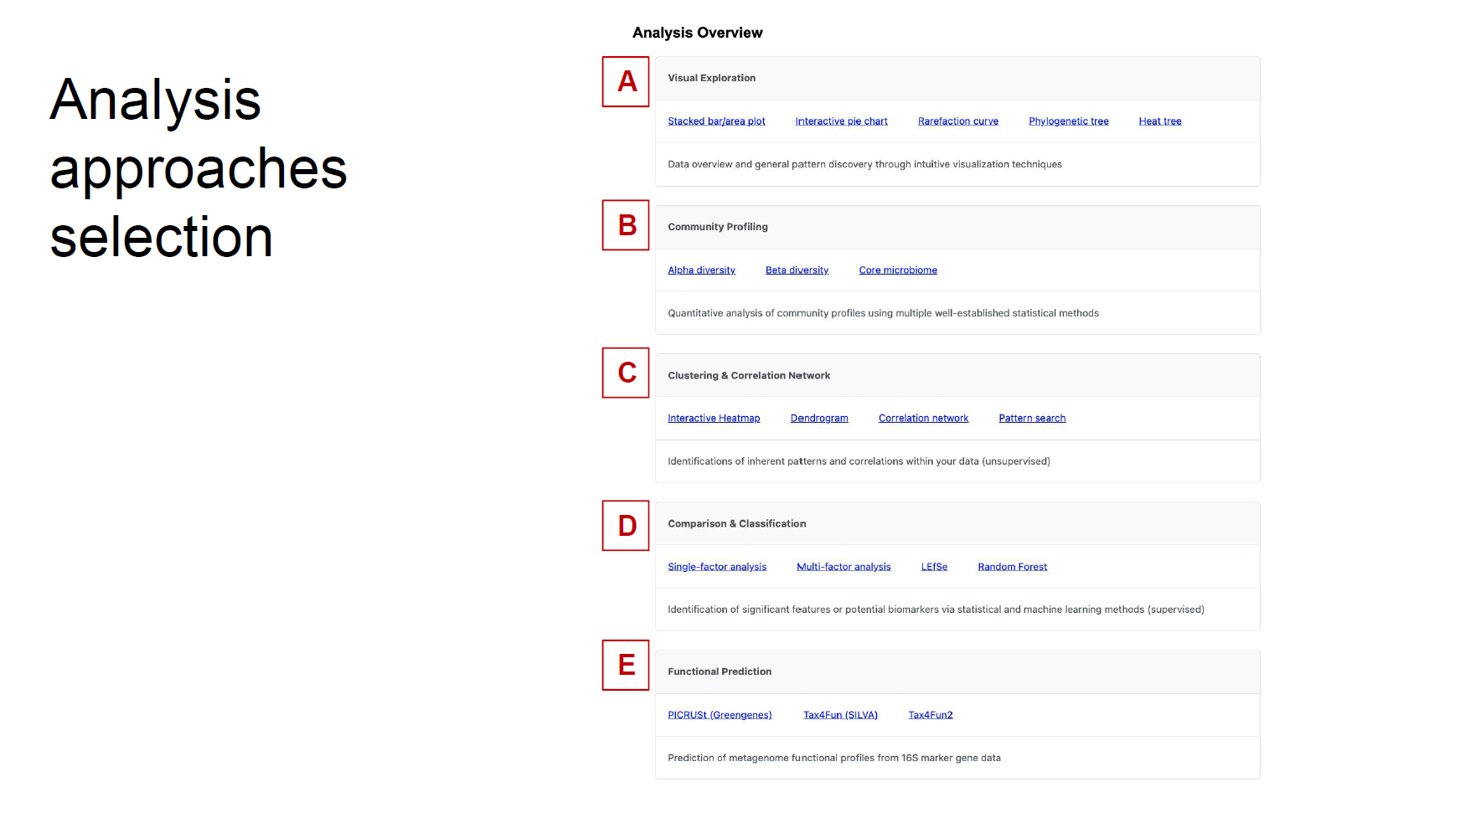

Slide 14
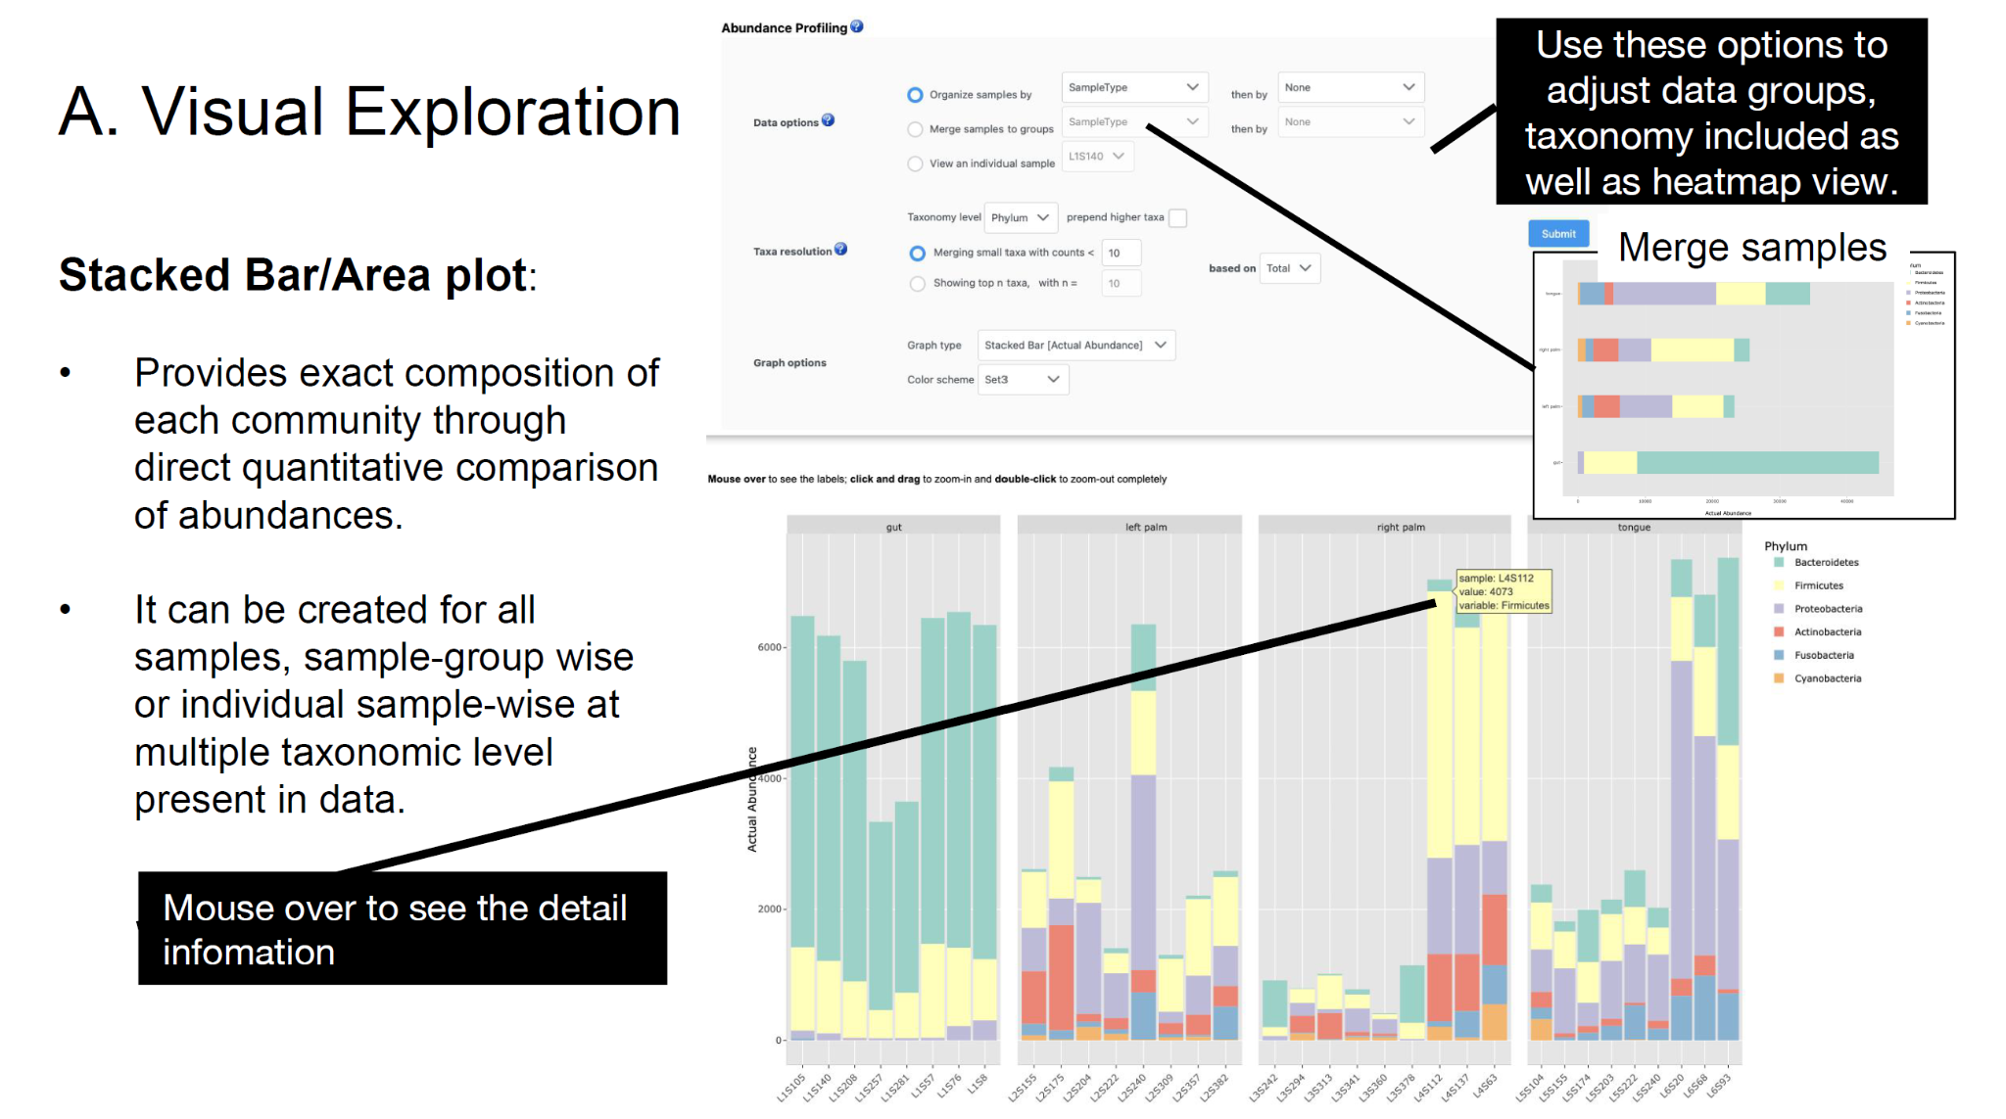

Slide 15
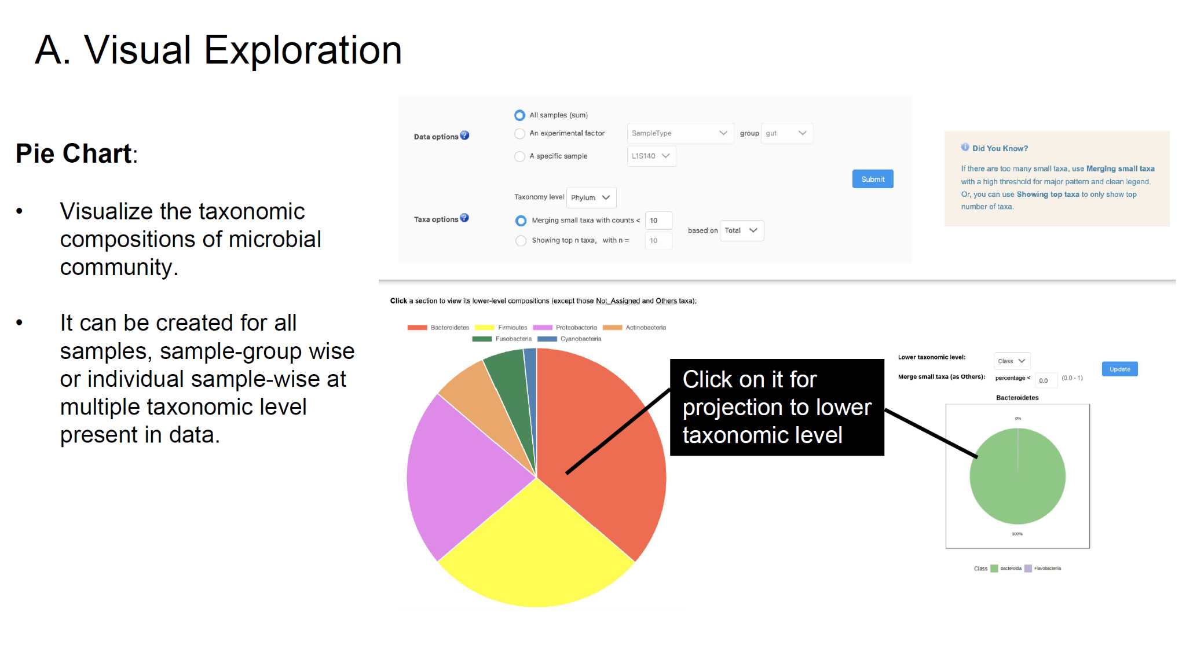

Slide 16
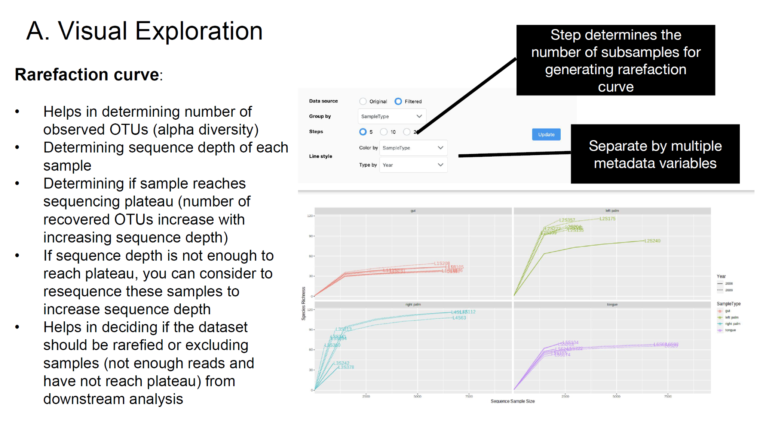

Slide 17
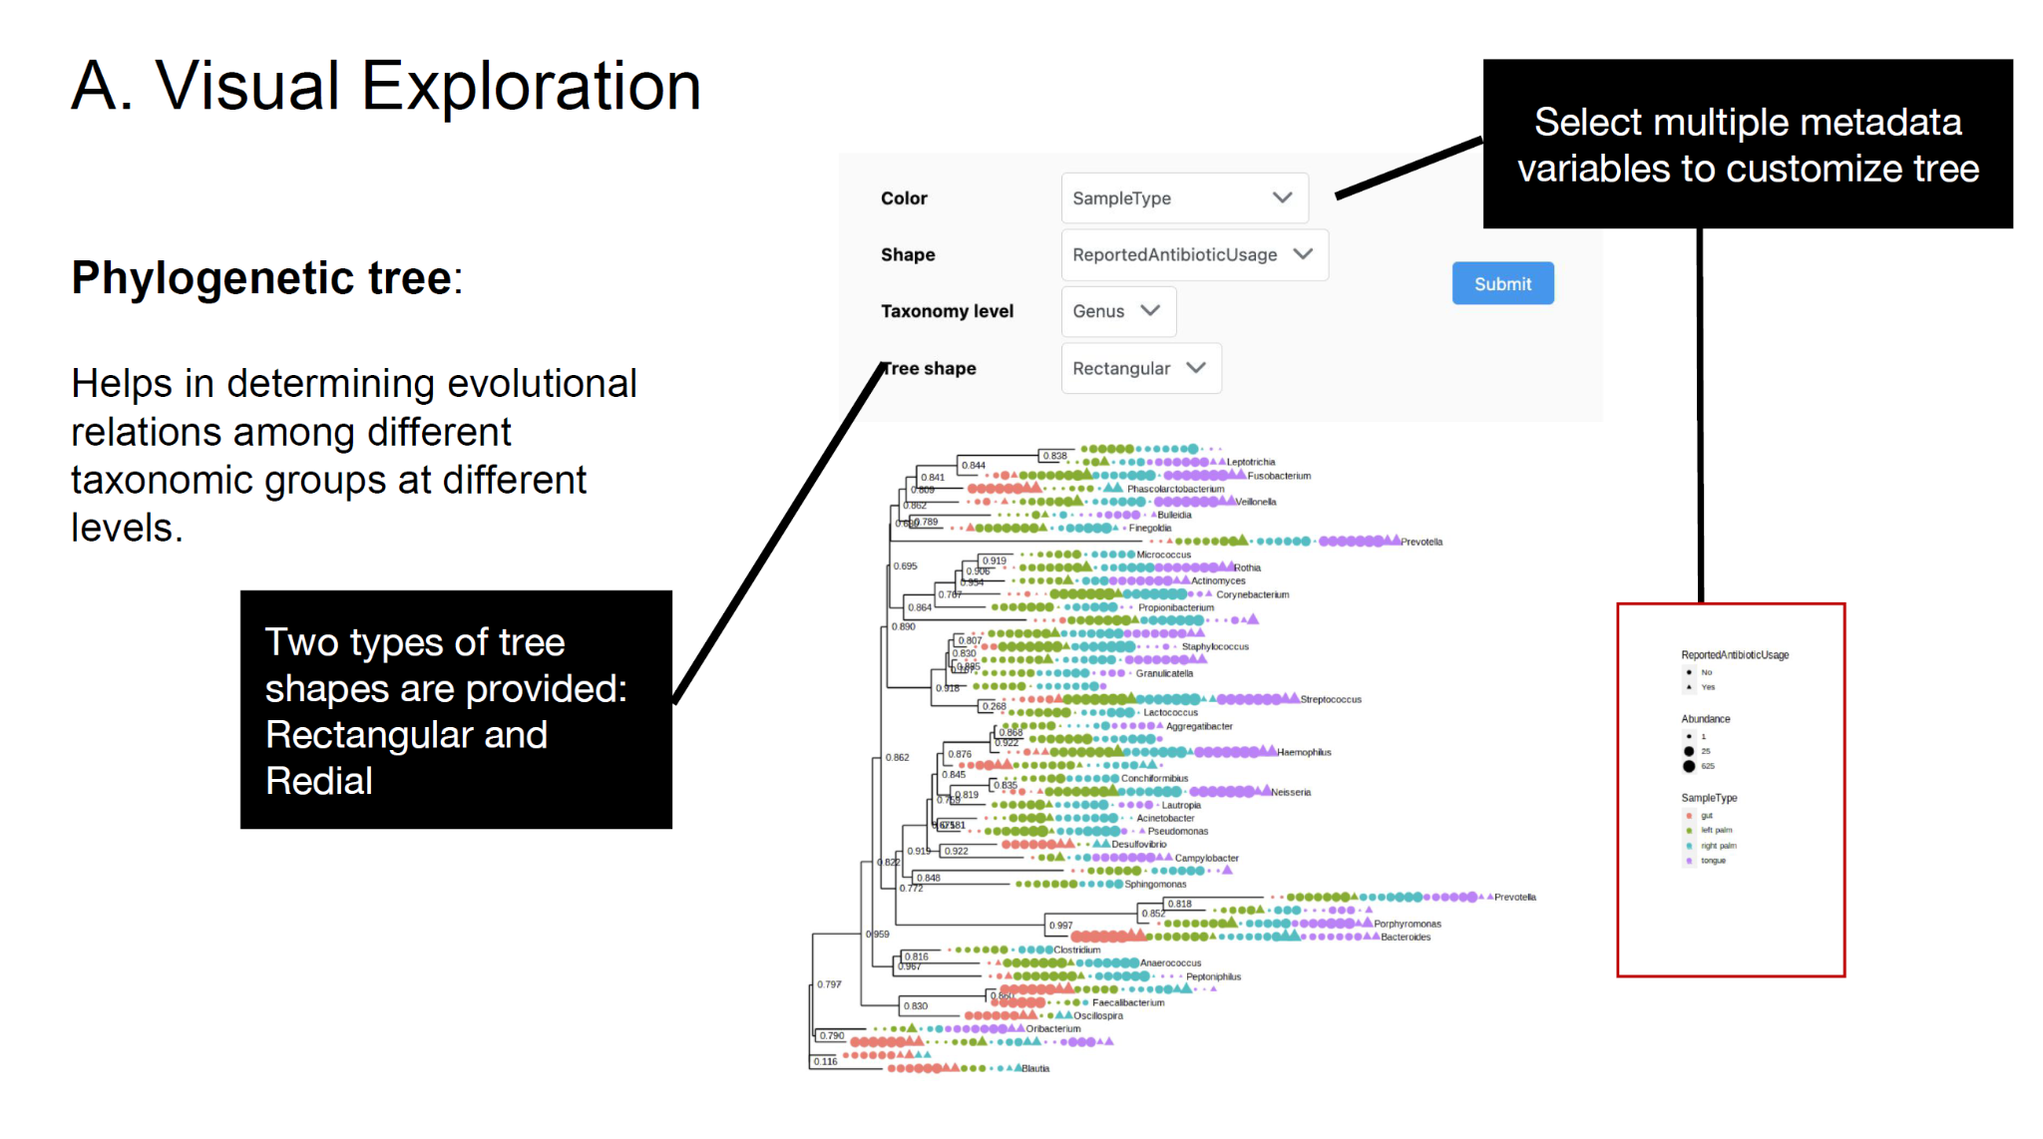

Slide 18
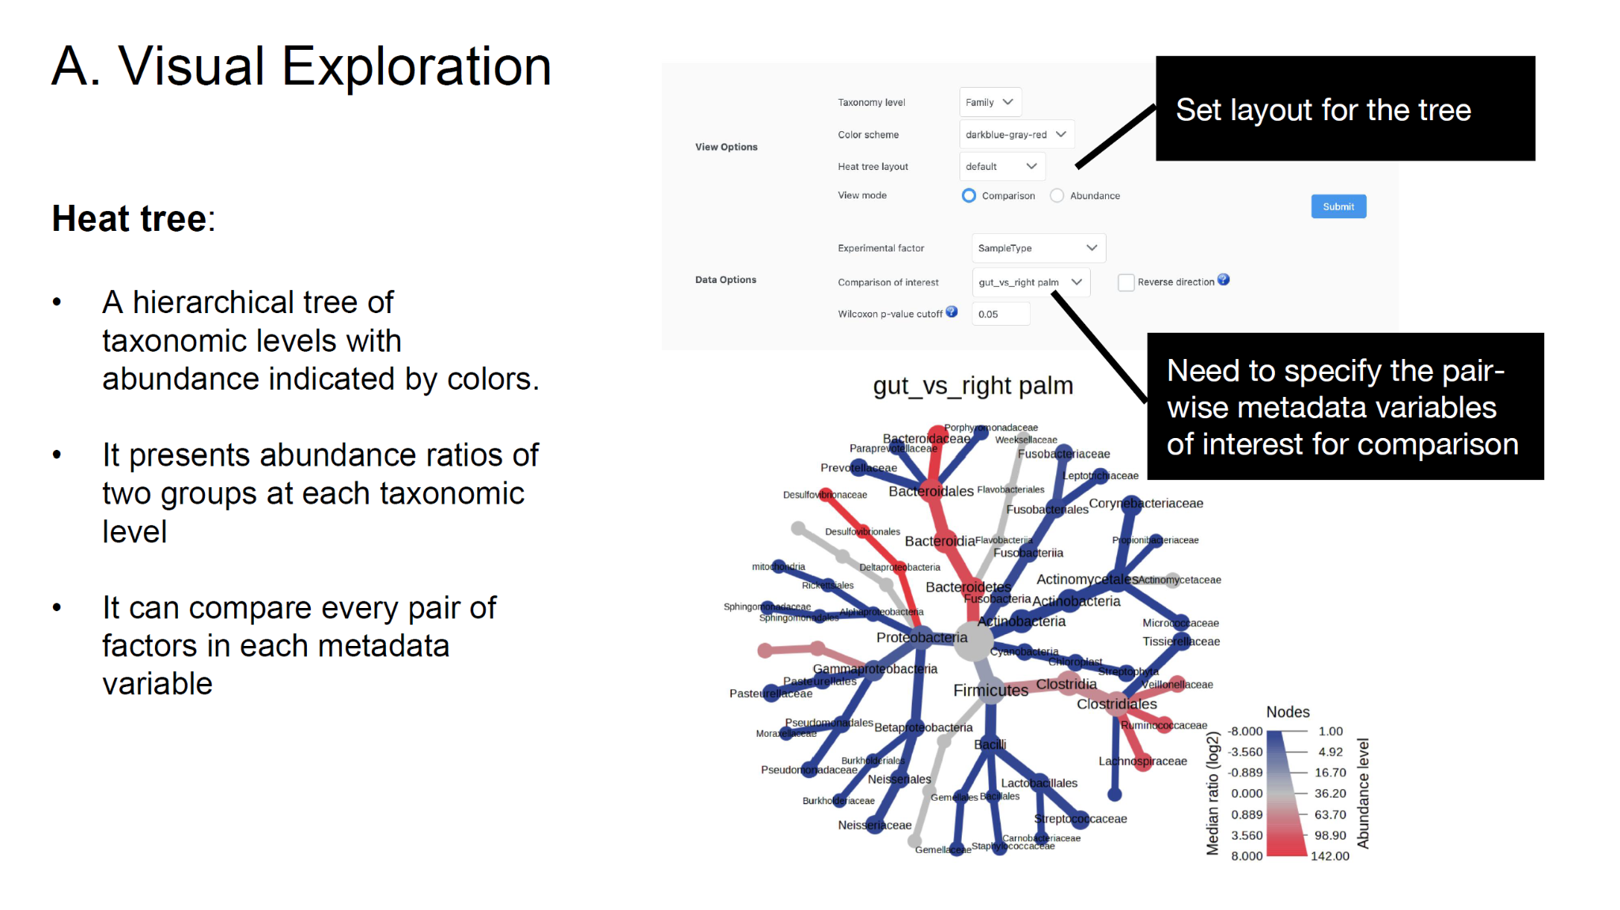

Slide 19
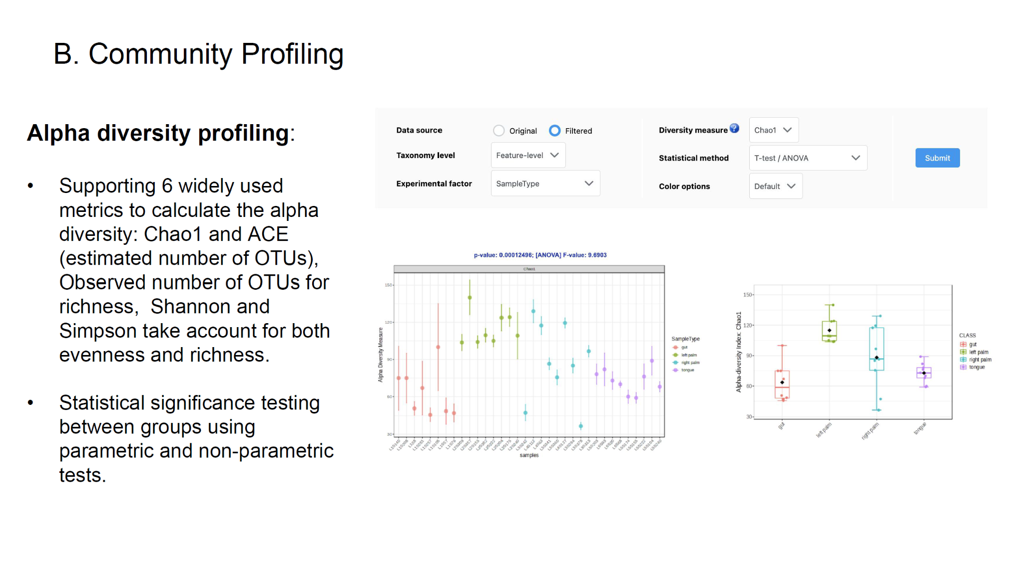

Slide 20
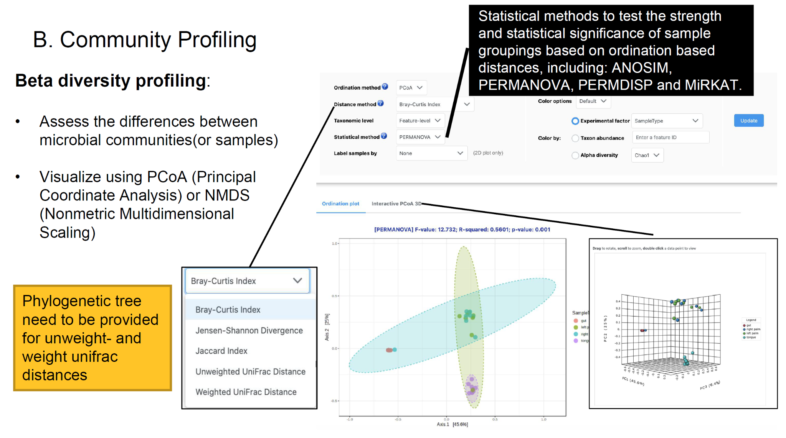

Slide 21
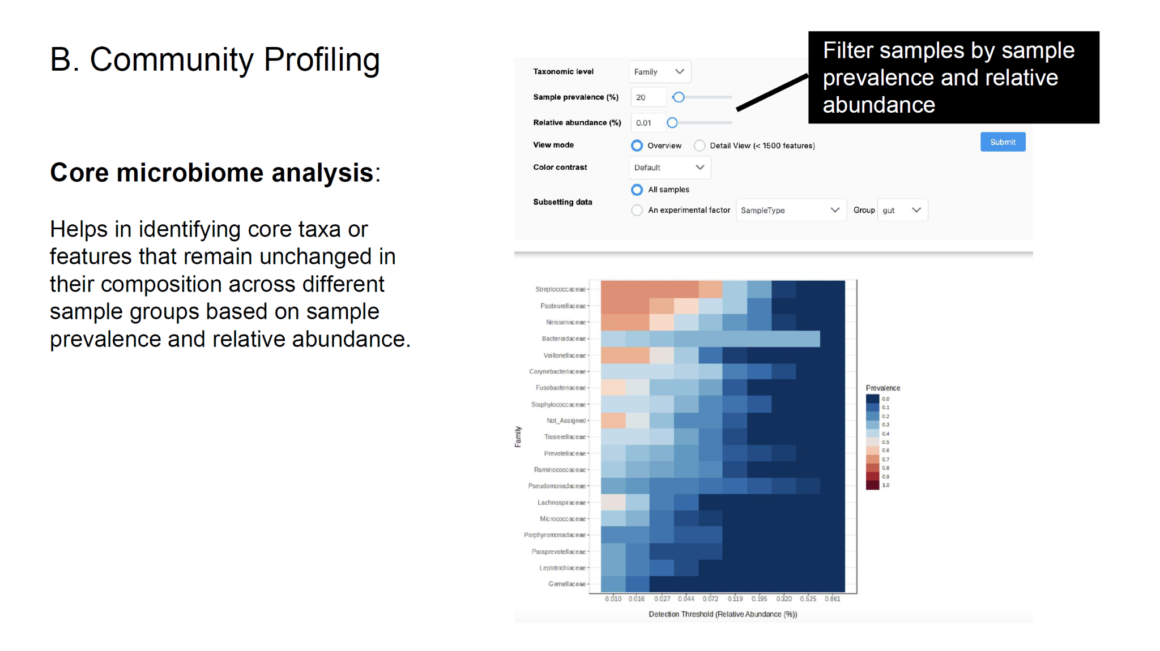

Slide 22
Observations and Comparisons
Parameter | Effect on Plot | Effect on Interpretation
Filtering | Fewer taxa shown | Dominant microbes stand out
TSS and Rarefaction | Changes proportions | Affects diversity and comparison
Genus and Family | More or less detail | Changes clarity
Plot type | Grouped / cleaner comparison | Improved visual quality

Slide 23
Key Takeaways
Parameter selection changes how you see your data.
Visualization helps make sense of complex microbiome patterns.
Community profiling = “Who’s there?”
Visual exploration = “What does it look like?”

Slide 24

Question to you
If you were analyzing real patient or environmental samples, which parameter setting would you prioritize first — and why?

Slide 25

Questions for us?

Slide 26
References
Dhariwal, A., Chong, J., Habib, S., King, I. L., Agellon, L. B., & Xia, J. (2017). MicrobiomeAnalyst: A web-based tool for comprehensive statistical, visual and meta-analysis of microbiome data. Nucleic Acids Research, 45(W1), W180-W188. https://doi.org/10.1093/nar/gkx295
Lu, Y., Zhou, G., Ewald, J., Pang, Z., Shiri, T., & Xia, J. (2023). MicrobiomeAnalyst 2.0: Comprehensive statistical, functional and integrative analysis of microbiome data. Nucleic Acids Research, 51(W1), W310-W318. https://doi.org/10.1093/nar/gkad407
Wemheuer, F., Taylor, J. A., Daniel, R., Johnston, E., Meinicke, P., Thomas, T., & Wemheuer, B. (2020). Tax4Fun2: prediction of habitat-specific functional profiles and functional redundancy based on 16S rRNA gene sequences. Environmental Microbiome, 15, 11. https://doi.org/10.1186/s40793-020-00358-7
xia-lab. (2023). MicrobiomeAnalystR [Computer software]. Retrieved from https://github.com/xia-lab/MicrobiomeAnalystR
Xia Lab @ McGill. (2025). Resources. MicrobiomeAnalyst. Retrieved October 19, 2025, from https://www.microbiomeanalyst.ca/MicrobiomeAnalyst/docs/Resources.xhtml

